Slide 1
Analysis of Transport Protocols for Smart Grid
Abhijith Dadaga Arkakeerthy
Mar 06, 2009
Dr. Isaac Ghansah
Department of Computer Science
California State University, Sacramento

Slide 2
Contents
Motivation
Smart Grid
Need for Transport Protocol
Project Scope
Methodology
Conclusion
Bibliography

Slide 3
Motivation
A person can send signals to control (turning ON/OFF) the devices within home. But he can neither send signals to devices from outside (over the internet) nor to Power Utilities requesting for power.
Power utilities have no way of knowing the demand (No feedback from consumer in real-time)
Solution: Smart Grid !!
Smart Grid relies on heavily on communication for its efficiency. Hence the analysis of Transport Protocols is important.

Slide 4
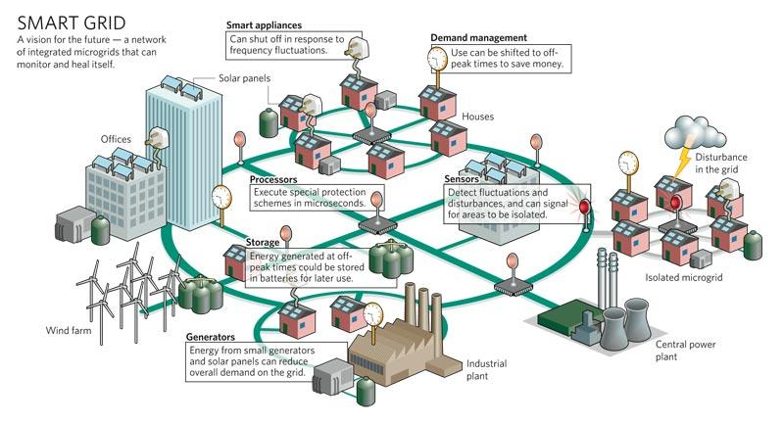
Smart Grid??
A power grid that is intelligent enough to make decisions of distributing electricity to a place where it is needed from a place where it is not being utilized (at that point of time).
Boulder city, CO - SmartGridCity
(Currently under experiment)

Slide 5
Need for Transport Protocol
Smart Grid relies heavily on the communication for its successful operation.
Usage data needs to be transported from customer site to the utility office for billing and also for statistics purpose – Normal (Data) traffic
Control Signals like Emergency, Critical, Normal state signals will be sent from the utility office to the consumer place to indicate the demand levels of the power. (which informs consumers to either reduce the consumption or to restore to normal operation) – Real Time traffic

Slide 6
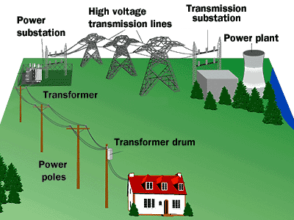
Project Scope
Communication between Utility Offices.
Communication between Utility Office and Consumer Place.

Slide 7
Methodology
Phase I (Feb 20 – Feb 27, Mar 6 – Mar 19):
  Brief study of Smart Grid
  Understand communicational characteristics of Smart Grid
  Identify a set of transport protocols to be analyzed based on these characteristics
Phase II (Mar 20 – Mar 26, Apr 7 – Apr 16):
  Analyze the transport protocols identified
Phase III & Phase IV (Apr 17 – Apr 30):
  Compare main characteristics of Protocols
  Propose a protocol

Slide 8
Identification (Phase I)
Transport Protocol requirements of Smart Grid
Standard Transport Protocols
Latency or delay
Openness (non-proprietary protocol)
Standardization
Scalability
Congestion handling
segment size
Security
TCP
UDP
Stream Control Transmission Protocol (SCTP)
Fast TCP
Scalable TCP
Wireless Datagram Protocol (WDP )

Slide 9
Conclusion
Smart Grid is an efficient way of utilizing electricity.
Smart Grid depends on Transport Layer Protocols for its operation.
The analysis of Transport Layer Protocols helps us to identify and adopt the best suitable transport layer protocol(s) into the smart grid, and thereby increase the effectiveness and efficiency of the Smart Grid.

Slide 10
Bibliography
Market Requirements Document for Smart Grid: http://www.broadcastnewsroom.com/articles/viewarticle.jsp?id=529456
Universal Powerline Association Readies Powerline Communication Smart Grid and Command and Control Specifications: http://www.broadcastnewsroom.com/articles/viewarticle.jsp?id=529456
Transport Layer Protocols: http://en.wikipedia.org/wiki/Category:Transport_layer_protocols
Protocol Engineering Laboratory: http://www.eecis.udel.edu/~amer/PEL/poc/index.html
Survey of Transport Protocols Other than Standard TCP: http://www.evl.uic.edu/eric/atp/

Slide 11

Thank You
Thank You

